Slide 1
Correlation and Covariance

Slide 2
Covariance
Covariance is a measure of how much two random variables vary together.
It’s similar to variance, but where variance tells you how a single variable varies, co variance tells you how two variables vary together.
Notes:
Variance in slope estimate
http://ib.berkeley.edu/courses/ib162/Regress.htm

Slide 3
Covariance can take any value between -∞ to +∞
The negative value is an indicator of negative relationship whereas a positive value represents the positive relationship.
Zero value indicates no relationship. Happens when all the observations of the either variable are same.
It ascertains the linear relationship between variables.

Slide 4
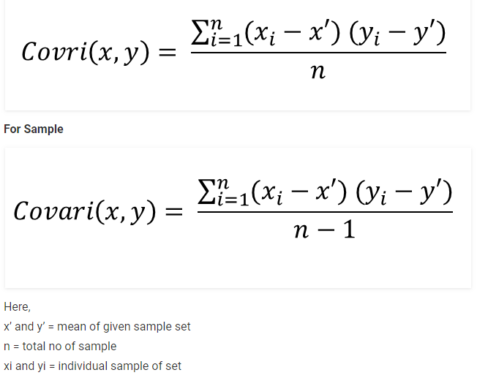
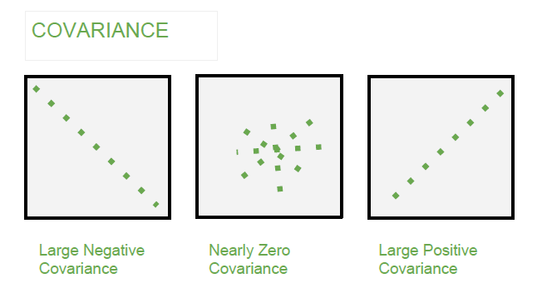

Slide 5
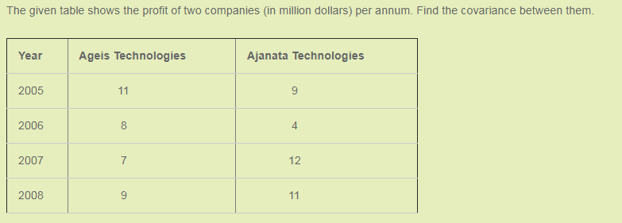
Example

Slide 6
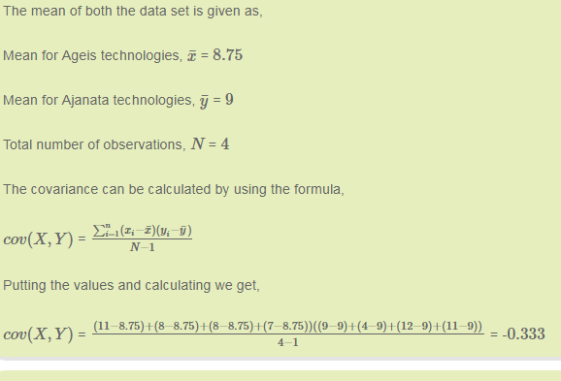
What does this mean??? Is the covariance less???

Slide 7

Lets look another example…..
When we find the covariance, Its value is -125000
What does this mean??? Is the covariance More???
Kinder Joy Unit Price(Rs) | Sales (Units)
35 | 200000
37 | 180000
40 | 150000
42 | 130000
45 | 100000
We should always look at just the sign for covariance. The
Magnitude is always meaningful

Slide 8
Correlation Analysis
Degree of Relationship/Association b/w continuous variable
Determines the degree to which two or more random variables move in tandem.
A correlation is assumed to be linear (following a line)
The value of correlation lies between -1 to +1, wherein values close to +1 represents strong positive correlation and values close to -1 is an indicator of strong negative correlation.
Correlation does not mean causation

Slide 9
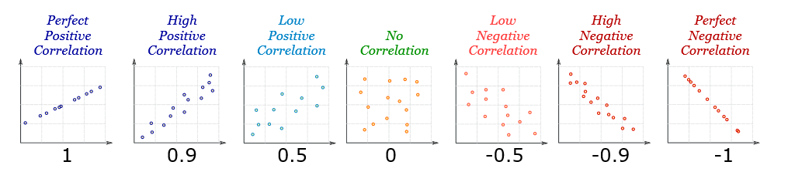

Slide 10
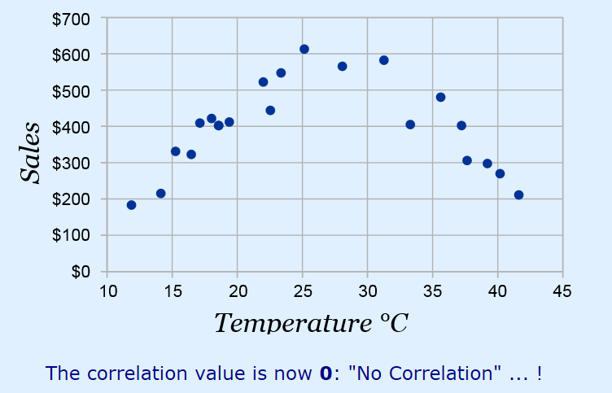
There may be a non-linear association between two continuous variables, but computation of a correlation coefficient does not detect this.

Slide 11


Slide 12



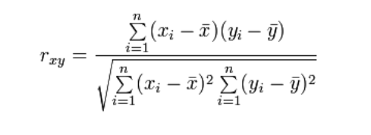

Slide 13
Lets look at the same example again…..
When we find the correlation, Its value is -1
What does this mean??? Is there a strong correlation??
Kinder Joy Unit Price(Rs) | Sales (Units)
35 | 200000
37 | 180000
40 | 150000
42 | 130000
45 | 100000
The value Closer to 1 or -1 always mean a strong correlation and the value close to 0 always mean a weak correlation

Slide 14
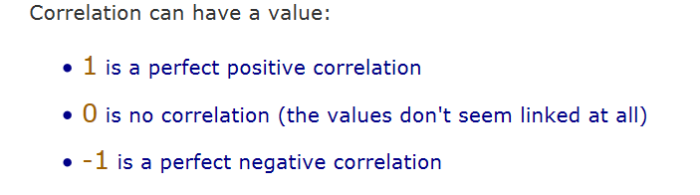
Correlation is Positive when the values increase together, and
Correlation is Negative when one value decreases as the other increases
Notes:
https://www.mathsisfun.com/data/correlation.html

Slide 15
ggplot(data=mtcars, aes(x=disp, y=mpg))+geom_point(size=2)
cor(mtcars$mpg, mtcars$disp)
Notes:
https://www.mathsisfun.com/data/correlation.html

Slide 16
Autocorrelation
Correlation with own lag values

Slide 17
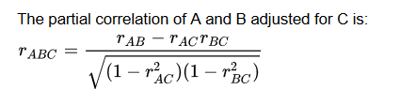
Partial correlation
Partial correlation is a measure of the strength and direction of a linear relationship between two continuous variables whilst controlling for the effect of one or more other continuous variables (also known as 'covariates' or 'control' variables).
pcor.test(x, y, z)

Slide 18
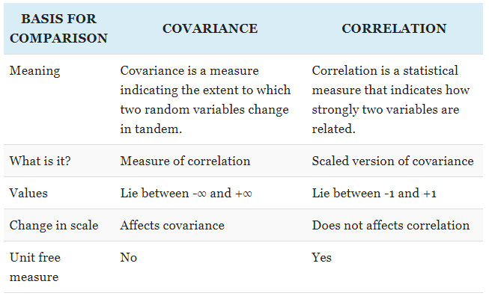

Slide 19
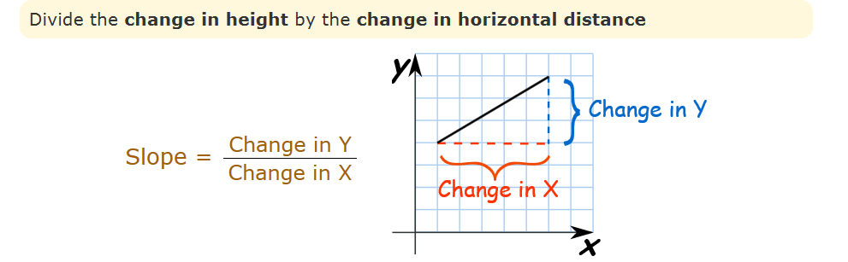
Slope
Slope is the measure of the steepness of a line
Slope how much y increases as x increases.

Slide 20
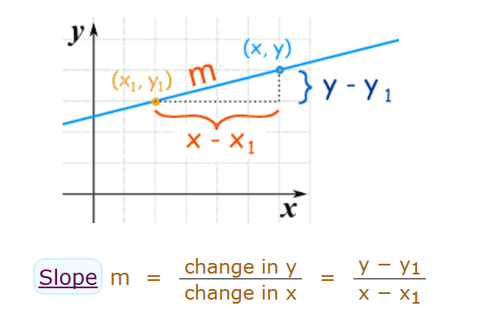

Slide 21
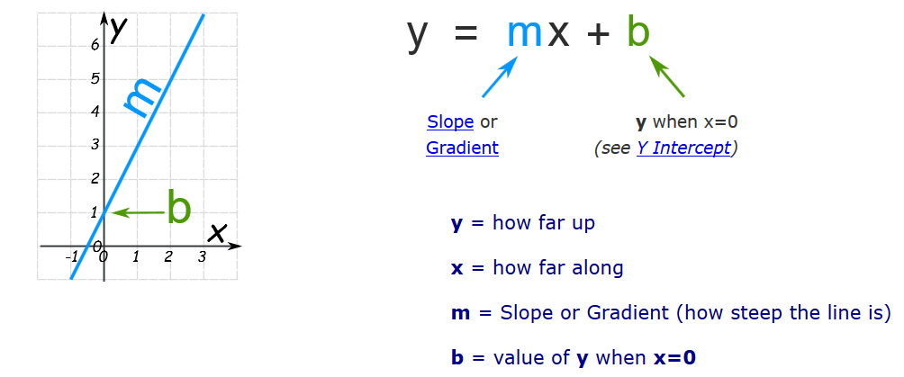

Slide 22
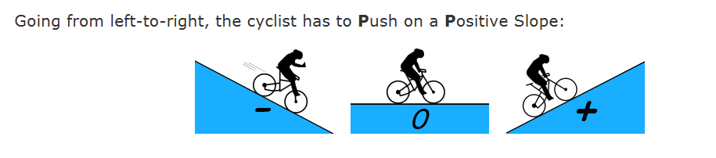
Notes:
https://www.mathsisfun.com/geometry/slope.html

Slide 23
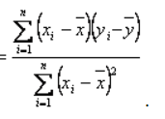

Slope relationship with Correlation and Covariance
Slope

Slide 24
Gradient
The gradient is like the slope, except here, the function whose rate of change we wish to study depends on more than one variable, i.e. f = f(x,y) . In other words f is multidimensional.
Notes:
https://www.quora.com/What-is-the-difference-between-slope-and-gradient

Slide 25
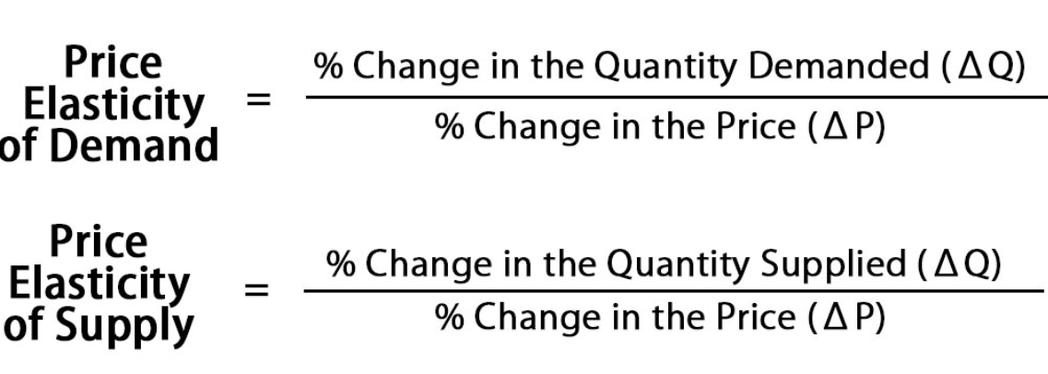
Elasticity
Elasticity is a measure of a variable's sensitivity to a change in another variable.
In business and economics, elasticity refers the degree to which individuals, consumers or producers change their demand or the amount supplied in response to price or income changes.

Slide 26
Independent/Input/predictor variable
An independent variable is exactly what it sounds like.
It is a variable that stands alone and isn't changed by the other variables you are trying to measure.
For example, someone's age might be an independent variable. Other factors (such as what they eat, how much they go to school, how much television they watch) aren't going to change a person's age.
In fact, when you are looking for some kind of relationship between variables you are trying to see if the independent variable causes some kind of change in the other variables, or dependent variables.
Notes:
https://nces.ed.gov/nceskids/help/user_guide/graph/variables.asp

Slide 27
Dependent/Output/response variable
Just like an independent variable, a dependent variable is exactly what it sounds like.
It is something that depends on other factors.
For example, a test score could be a dependent variable because it could change depending on several factors such as how much you studied, how much sleep you got the night before you took the test, or even how hungry you were when you took it.
Usually when you are looking for a relationship between two things you are trying to find out what makes the dependent variable change the way it does.

Slide 28
Which one is independent/dependent ?
No of hrs AC is switched on and electricity bill
For every mile you run, you burn 100 calories.
Sales and Price
Ice-cream Sales and Temperature
Prediction of default based on credit history, amount of loan
Movie popularity vs ticket price
House/PG price based on location, amenities

Slide 29
Supervised Learning
Supervised statistical learning involves building a statistical model for predicting, or estimating, an output based on one or more inputs.
To understand the association between an employee’s age and education, as well as the calendar year, on his wage.
The Wage data involves predicting a continuous or quantitative output value. This is often referred to as a regression problem.
However, in certain cases we may instead wish to predict a non-numerical value—that is, a categorical.
Predicting whether a given day’s stock market performance will fall into the Up bucket or the Down bucket. This is known as a classification problem.

Slide 30
Regression Versus Classification Problems
Variables can be characterized as either quantitative or qualitative/categorical .
Quantitative variables take on numerical values.
– a person’s age, height, or income, the value of a house, and the price of a stock.
In contrast, qualitative variables take on values in one of K different classes, or categories.
– a person’s gender (male or female), the brand of product purchased (brand A, B, or C), whether a person defaults on a debt (yes or no)
Problems with a quantitative response are usually regression problems
Problem involving a qualitative response are often referred to as classification problems.

Slide 31
Unsupervised Learning
With unsupervised statistical learning, there are inputs but no supervising output; nevertheless we can learn relationships and structure from such data.
We only observe input variables, with no corresponding output.
For example, in a marketing setting, we might have demographic information for a number of customers.
We may wish to understand which types of customers are similar to each other by grouping individuals according to their observed characteristics. This is known as a clustering problem.
Unlike in the previous examples, here we are not trying to predict an output variable.

Slide 32
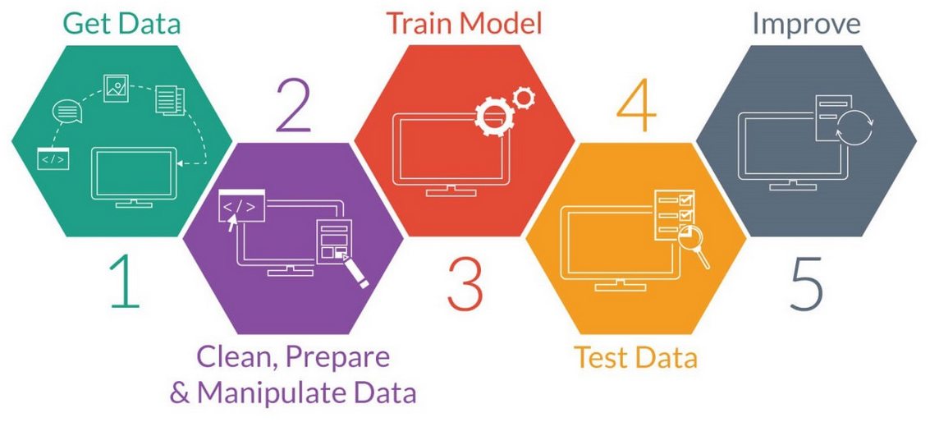
Problem Solving in Analytics

Slide 33
Cost Function
It is used to predict O/P at different levels of I/P
Eg 1:
A sunglass manufacturer is planning production of new varieties of sunglasses. For the first year, the fixed costs for setting up a new production line is 1.25 Lakhs. Variable cost for producing each piece of sunglasses are Rs 35. They plan to sell each @ 160 Rs.
Find the profit if 1100 pcs are sold
Find the break even point
Eg 2:
The management of Duralex Companies, a manufacturer of toys, has asked for a new cost study to improve next year’s budget forecasts. They pay rent of $300 a month and they pay an average of $30 a month for electricity. Each toy requires $5 in plastic and $2 in cloth.
How much will it cost them to manufacture 1200 toys annually?
How much will it cost them to manufacture 1500 toys annually?

Slide 34
Problem Solving with Analytics
Recognizing a problem
Structuring the problem
Analyzing the problem
Implementing results and making a decision
Implementing the solution
Defining the problem

